Slide 1
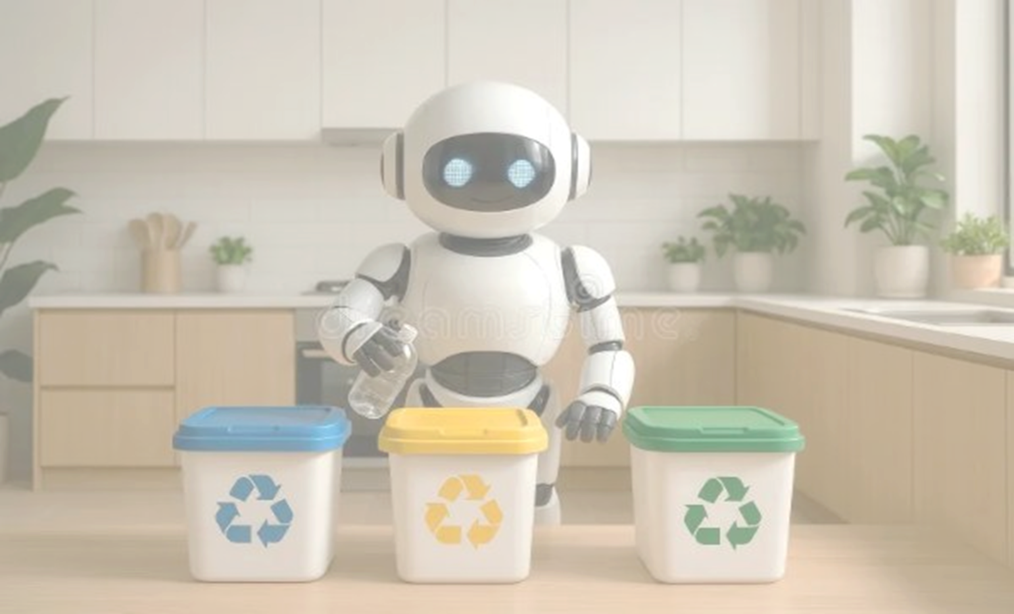

Team: Adrija (24BEC0362)
Chaithyak (24BEC0715)
Anusha (24BEC0649)
Slot: C2+TC2
SEGREGATOR BIN
Segregates wet waste from dry ones

Slide 2
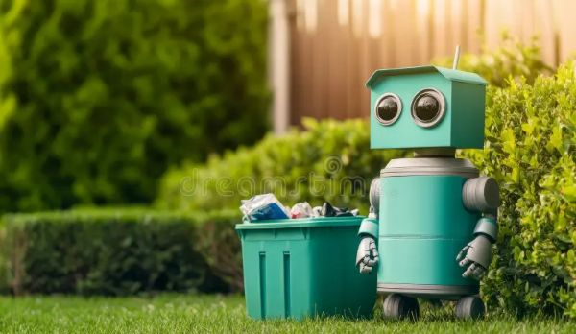
1
Motivation and Rationale
2
Unique Selling Proposition
3
Components Used
4
Tinkercad Simulation Overview
5
Arduino Code
6
Benefits and Applications
7
Problems Addressed
CONTENTS

Slide 3

Drive source-level segregation
MOTIVATION
Protects public health & environment
and
RATIONALE
Safeguards sanitation workers
Enables circular economy practices
Leverages affordable automation

Slide 4

UNIQUE
SELLING
Automatic waste separation (no manual sorting)
PROPOSITION
Boosts recycling and composting efficiency
Improves hygiene and worker safety
Saves time and reduces labor costs
Eco-friendly and sustainable

Slide 5
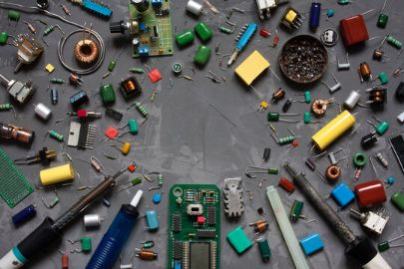
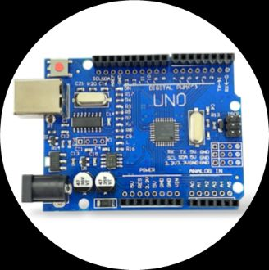


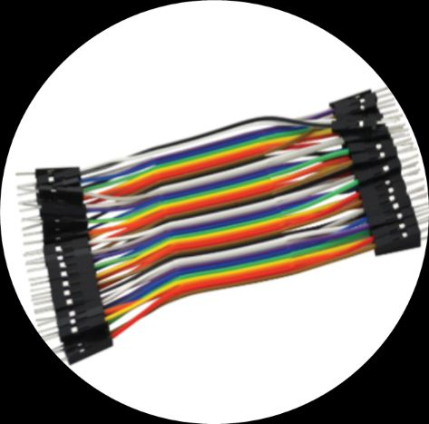
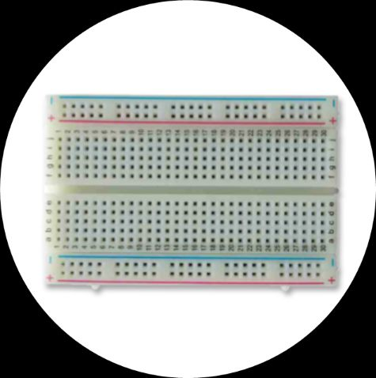
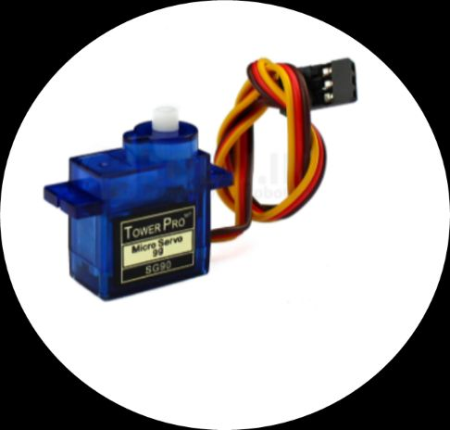

Arduino Board
Soil Moisture Sensor
USB Cable
COMPONENTS
Jumper Wires
Breadboard
Servo Motor
Ultrasonic Sensor

Slide 6

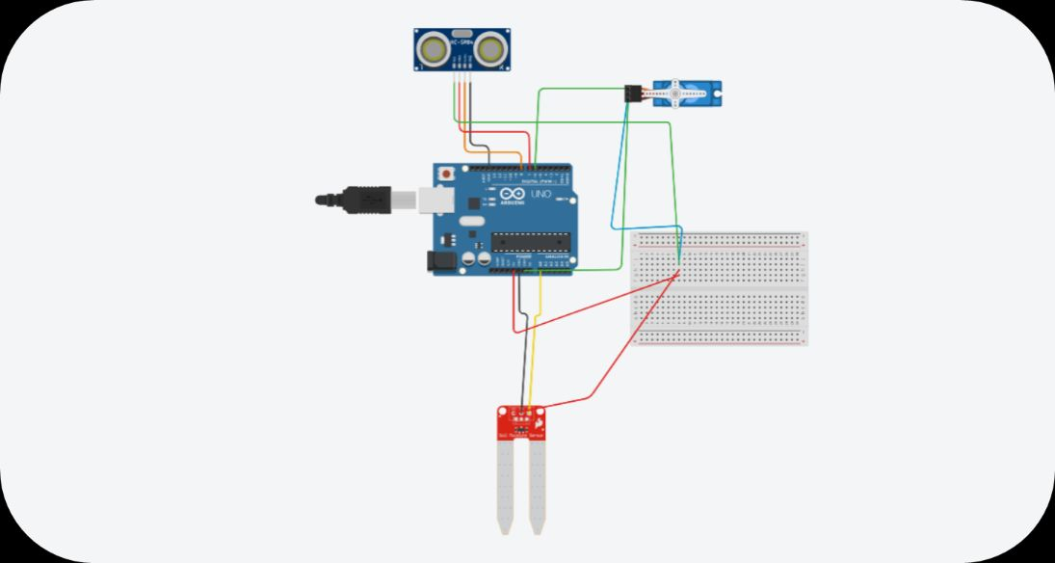
TINKERCAD SIMULATION OVERVIEW

Slide 7
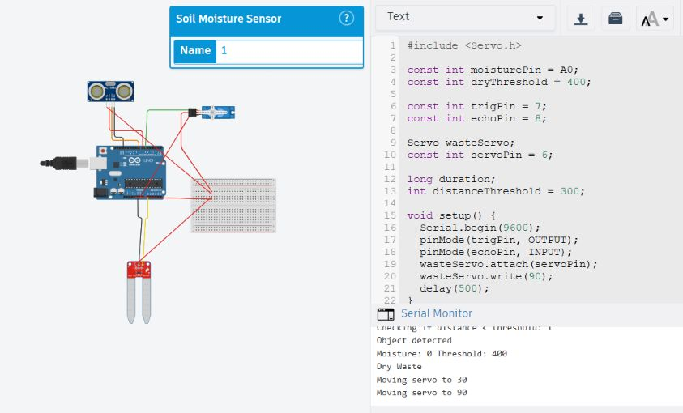
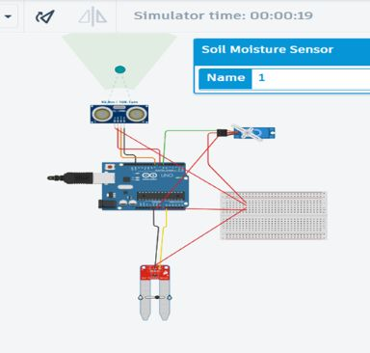
Detection of Dry-Waste
Once object is in range, since moisture detected is 0, servo motor swings 30 degrees and back to its original position again.

Slide 8
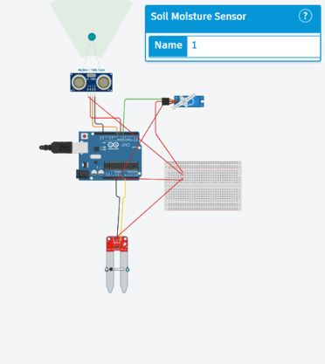
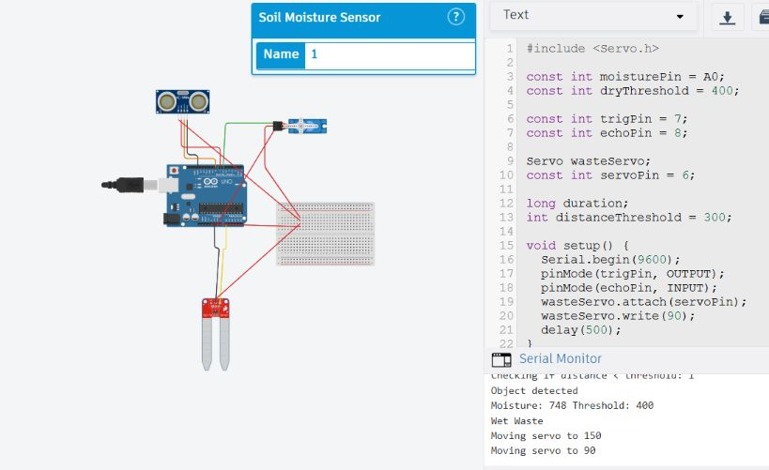
Detection of Wet-Waste
Once object is in range, since moisture detected is above threshold value of 400, servo motor swings 150 degrees and back to its original position again.

Slide 9

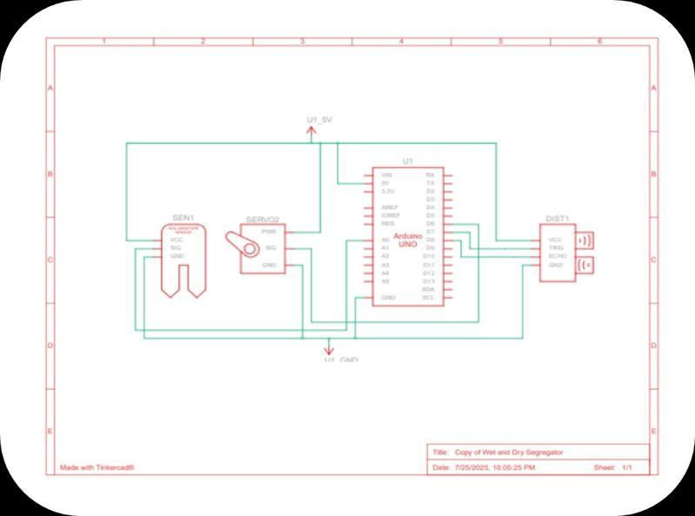
SCHEMATIC
DIAGRAM

Slide 10

"Teamwork fuels our dreams, and every week is a new opportunity to soar higher together."
https://www.tinkercad.com/things/ex2AVPhqx3l-copy-of-wet-and-dry-segregator/editel?returnTo=https%3A%2F%2Fwww.tinkercad.com%2Fdashboard&sharecode=Q5eYpUerMk-cSHI5bxBYfHNL0rKgXRzQgM_EasK-Jjg
DENOVAN WRIGHT
ARDUINO CODE

Slide 11
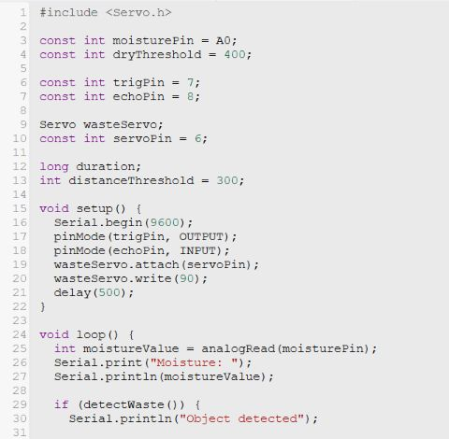
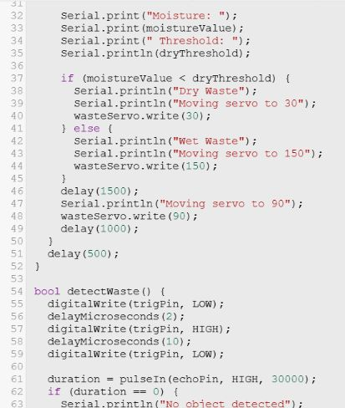

Project Code

Slide 12
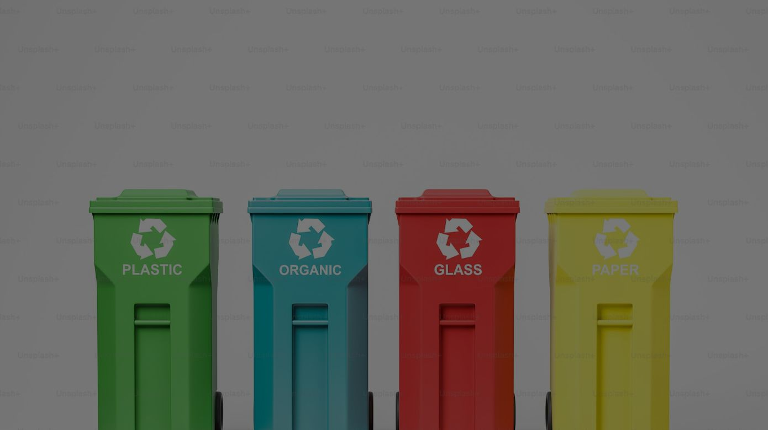
Benefits
Automated waste segregation, reducing manual labor.
Improves accuracy in sorting dry and wet waste.
Enhances hygiene by limiting human contact with waste.
Promotes recycling and reduces landfill pressure.
Supports real-time monitoring via IoT integration.
Saves time and increases operational efficiency.
Ensures compliance with waste management rules.

Slide 13

Applications
Homes – Smart bins for household waste sorting.
Municipal services – Public waste segregation and sorting.
Hospitals – Safe disposal of medical and organic waste.
Offices & malls – Streamlined commercial waste management.
Airports & stations – Handles high-volume public waste.

Slide 14
Thank You
Team Members:
Adrija (24BEC0362)
Chaithyak (24BEC0715)
Anusha (24BEC0649)

